Slide 1


OLYMPUS TECH 2.0 - CUBESAT
TEAM:
Affan Pathan
L Shreya
Prathamesh Nerpagar

Slide 2
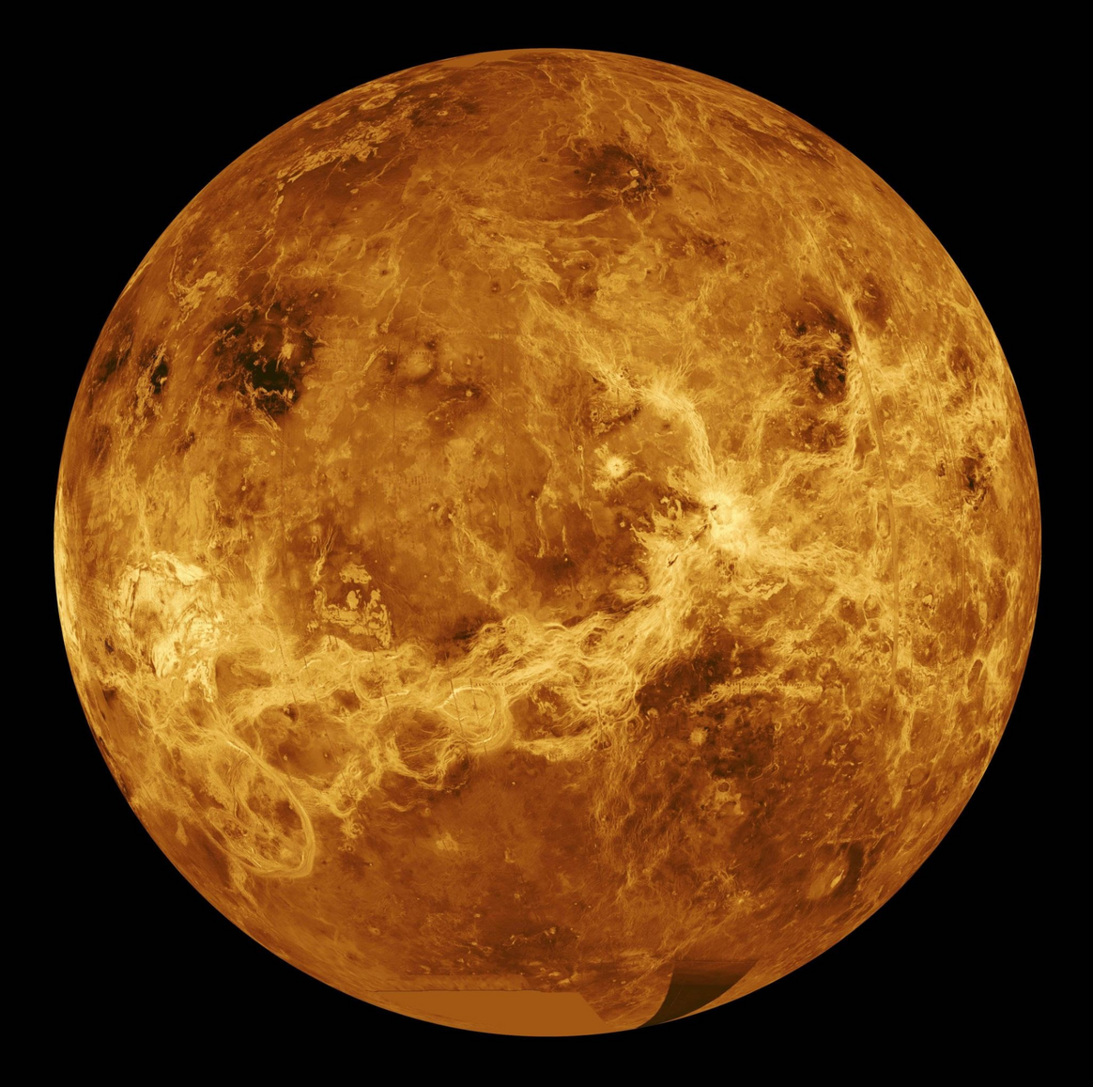
Designing Conditions
Orbiting venus near exosphere
2. Temperature variations of 180-300K.
3. Presence of high amount of solar radiation against satellite
4. Acidic corrosive atmosphere
5. 30 days life expectancy of the satellite

Slide 3

Satellite Constraints
The satellite is designed for orbiting a polar orbit around the planet such that it doesnt go into shadow for long periods
2. The weight of satellite is 1.48Kg
3. Theres a presence of a larger satellite serving as relay for communication from earth.
Due to weight and power constraints, we cannot fit a long range communication system in the satellite itself.

Slide 4

Design
Satelllite features an always sun facing heat shield.
The heat shield is coated with highly refletive coating to reflect back maximum possible radiation in space
Two lateral sides of satellite feature solar panels, which are retractable with help of two actuators.
The solar panel also has an infrared radiator which rejects heat to the shadow side
The planet facing side of the satellite has a flap cover for payload, exposing an array of sensors and cameras to assess the planet
The solar panels on opening expose the sensor array to the surface of the planet

Slide 5
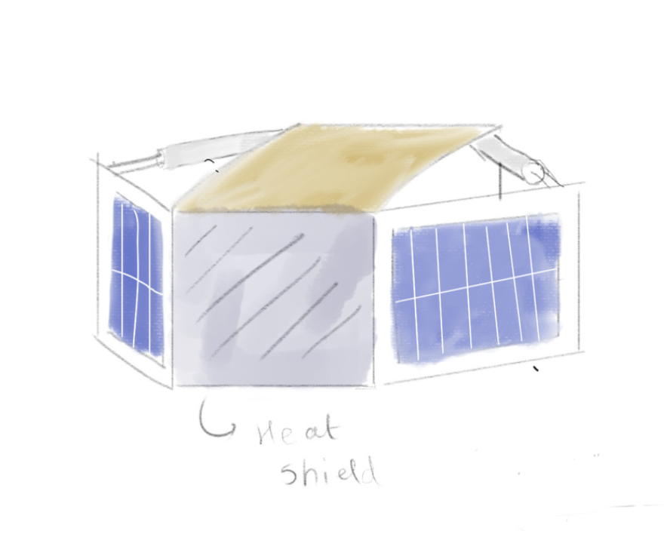
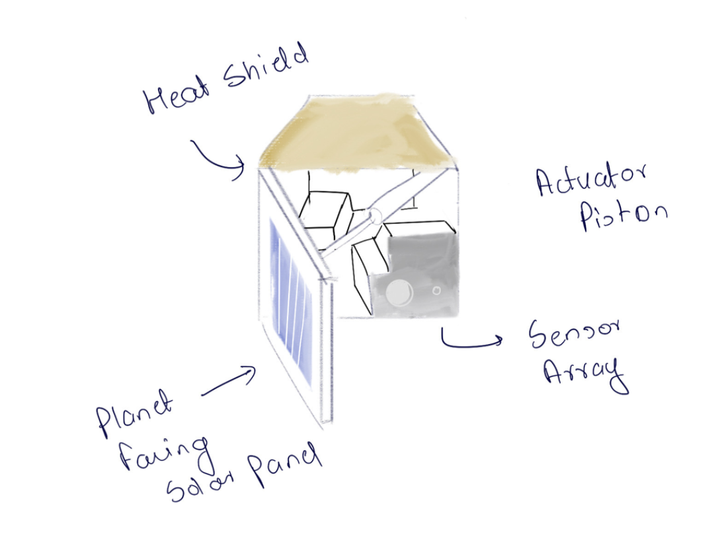
DESIGN SKETCH:

Slide 6
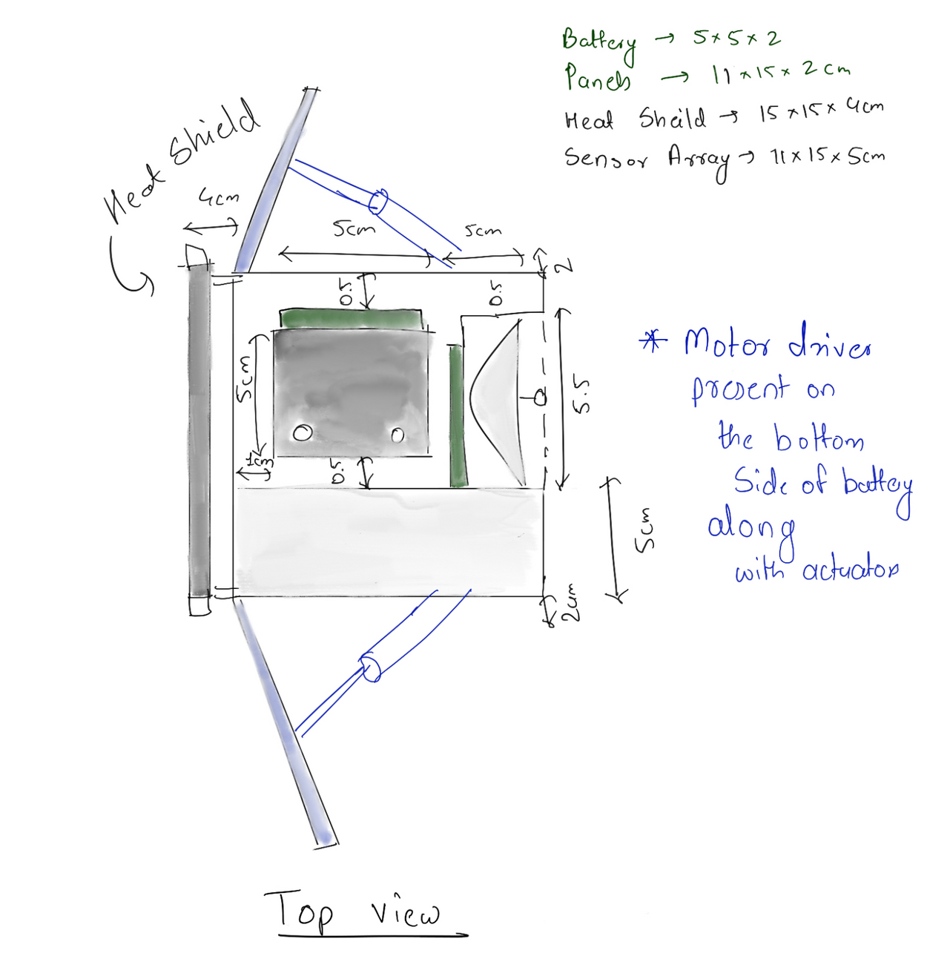

Slide 7
Censors and Data Collection
Standard High-Res imager for surface photos
Thermal imager for analysing winds
UV and IR spectrometers for analysing the gases in atmosphere
Magnato-meter for analysing magnetic field
All electronics will be radiation hardened

Slide 8
Materials
Body mad of carbon fibre
-> lightweight
-> 1.6gm/cm3
2. Heat shield made of aluminium, coated with highly reflective materials
->2.7gm/cm3
3. High density Li-CFx battery
-> Not rechargable, but packs punch
->100gm battery ; 200W/Hr
-> Bears high temps till 400C
4. Gold foil coating for exterior

Slide 9
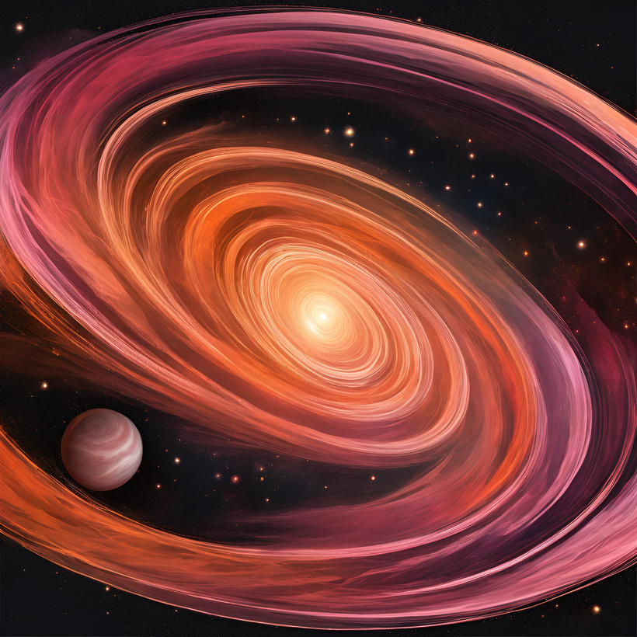
Weights
Solar panels : 350gm ; 15-20W/Hr
2. Heat shield : (15*15*1)cm *2.7gm/cm3 = 607.5gm
3. Battery packs : 100gm Li-CFx
4. Electronics and sensors : 125gm
5. Body:
6*(15cm long+0.5cm diameter)
3*(15*15*0.25)
panels = 168.75cm3
total weight = 185.75*1.6gm/cm3 = 297gm
TOTAL WEIGHT : 1.48Kg

Slide 10
Issues
The weight is 1.5Kg, while 1Kg was expected. This is due to requirment for heat proofing equipment
2. Requirement for relay of comms the satellite. Cannot send signals directly to earth, needs a relay near venus
Refernces
Li-CFx Battery : https://pubs.rsc.org/en/content/articlelanding/2023/ee/d2ee04179k
2. Radiation shielding :

Slide 11

QUESTIONS?

Slide 12


